Slide 1


Title: Implementation of Industry-Standard RS-485 MODBUS Serial Communication with Arduino for EV Battery Charging Relay Control With Cloud
Submitted by: Athish J D, Darsan L M, M Akash, S Praveen Institution: Amrita School of Engineering, Amrita Vishwa Vidyapeetham, Coimbatore Date: 28th March 2025

Slide 2
Topics of Discussion
Introduction
Problem Statement
Proposed Solution
System Architecture
Hardware & Software Components
Modes of Operation & System Operation Flow
Results & Outcomes
Conclusion

Slide 3
Introduction
Aim: Develop a smart EV battery charging system using RS-485 MODBUS communication and ESP32-based cloud integration.
Key Features:
Manual and automatic relay control
Automatic cutoff based on current sensing
Remote monitoring and control via Blynk cloud
Objective: Improve safety, maximize battery life, and enable cloud-based monitoring.

Slide 4
Problem Statement
Need for Efficient and Safe EV Battery Charging:
Electric Vehicles (EVs) are becoming increasingly popular, requiring efficient and safe charging methods to ensure long battery life and reliable performance.
Overcharging, undercharging, and irregular charging cycles can significantly impact battery health and longevity.
A reliable and automated charging system is necessary to prevent battery damage and maximize efficiency.
Challenges in Implementing MODBUS Communication with Arduino for Relay Control:
MODBUS is an industry-standard protocol widely used for communication between electronic devices, but integrating it with Arduino poses several challenges.
Arduino lacks native support for MODBUS, requiring external components like the MAX485 module for RS-485 communication.
Ensuring accurate data transmission and handling communication delays can be difficult when managing multiple devices.
Proper synchronization between the ESP32 (cloud interface) and Arduino (relay controller) is crucial for a seamless operation.
Need for Remote Monitoring and Control of Battery Charging:
Traditional EV charging systems often lack remote monitoring capabilities, limiting user control and real-time supervision.
A cloud-based solution with ESP32 and Blynk integration allows users to monitor battery status, control charging, and receive alerts from anywhere.
Remote accessibility enhances user convenience and enables proactive maintenance, preventing potential battery issues.

Slide 5
Proposed Solution
Use of RS-485 MODBUS for Reliable Serial Communication:
MODBUS protocol enables robust and noise-resistant communication between microcontrollers and industrial devices.
RS-485 supports long-distance data transmission with high reliability, making it ideal for EV charging applications.
MAX485 module facilitates RS-485 communication between the Arduino and other components.
ESP32 for Cloud-Based Monitoring via Blynk:
ESP32 is a powerful microcontroller with built-in Wi-Fi and Bluetooth, allowing real-time data transmission to the Blynk cloud.
The Blynk app enables users to remotely monitor battery status, control charging, and receive notifications on mobile devices.
This implementation enhances user accessibility and control, preventing unnecessary overcharging or power wastage.
Implementation of an Automatic Relay Cutoff System:
A relay is used to switch the battery charging process ON/OFF automatically based on predefined thresholds.
The system utilizes an ACS712 current sensor to detect the charging status and trigger an automatic cutoff when full charge is reached.
Prevents overcharging, improves battery life, and ensures safety by avoiding excessive power consumption.

Slide 6
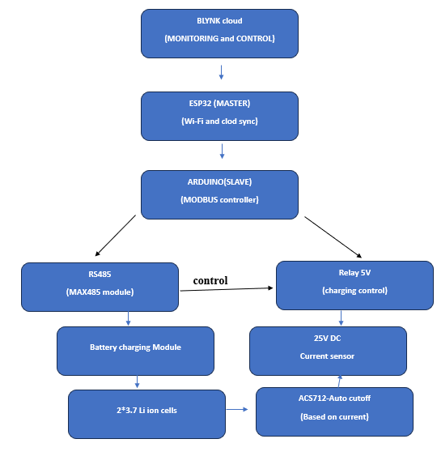
System Architecture
Block Diagram

Slide 7
Hardware Components
ESP32: Cloud integration and remote monitoring
Arduino Mega 2560: MODBUS communication and decision making
RS-485 (MAX485 Module): Serial communication
Relay Module: Charging ON/OFF control
25V DC Voltage & ACS712 Current Sensor: Battery monitoring
TP4056 Battery Charging Module: Safe charging
3.7V Li-ion 18650 Batteries

Slide 8
Software Implementation
Arduino Firmware (MODBUS Communication):
Reads sensor data
Controls relay switching
Communicates with ESP32
ESP32 Firmware (Blynk Integration):
Sends battery data to Blynk
Receives control commands
Blynk Cloud Dashboard:
Displays real-time battery status
Enables manual control and notifications

Slide 9
Modes of Operation
Manual Mode: Users can control relay ON/OFF via the Blynk app.
Automatic Mode: System detects full charge and stops charging.

Slide 10
System Operation Flow
Power ON – ESP32 connects to Blynk, Arduino initializes RS-485.
Charging Start – If battery is low, relay is activated.
Cloud Monitoring – ESP32 updates Blynk dashboard.
Auto Cutoff – Charging stops when full charge is detected.
Safety – TP4056 prevents overcharge.
Restart – Charging resumes when voltage drops.

Slide 11
Results and Outcomes
Remote Monitoring & Control: ESP32 with Blynk enables cloud-based access.
Efficient Charging: MODBUS communication ensures optimized control.
Automatic Cutoff: Current sensor prevents overcharging.
Safe & Scalable: Low-cost implementation with scalable potential.

Slide 12
Conclusion
Successfully implemented a smart EV battery charging system.
Improved safety, efficiency, and remote access.
Future work: Scaling for multiple battery packs and AI-based optimization.

Slide 13
Thank You
Questions & Discussion.

